Slide 1
Chapter – II
Public Key Cryptography
Number Theory concepts: Primes and Prime Factorization – Congruent modulo n, equivalent class modulo n, Integer modulo n, Multiplicative inverse, Relatively prime, Euler's theorem, Fermat's little theorem, Extended Euclidean Algorithm, Chinese Remainder Theorem. Confidentiality using Asymmetric Encryption – Public Key Cryptography and RSA- Key Management - Diffie-Hellman key Exchange – Elliptic Curve Architecture and Cryptography – Case study on Elan Financial Services

Slide 2
1.Introduction to Number Theory
Prime Numbers
Prime numbers only have divisors of 1 and self they cannot be written as a product of other numbers.
An integer p > 1 is a prime number if and only if its only divisors are ± 1 and ±p.
Note: 1 is prime, but is generally not of interest.
eg. 2,3,5,7 are prime, 4,6,8,9,10 are not.
Prime numbers are central to number theory.
List of prime number less than 200 is:
2 3 5 7 11 13 17 19 23 29 31 37 41 43 47 53 59 61 67 71 73 79 83 89 97 101 103 107 109 113 127 131 137 139 149 151 157 163 167 173 179 181 191 193 197 199

Slide 3

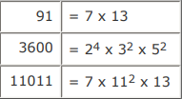
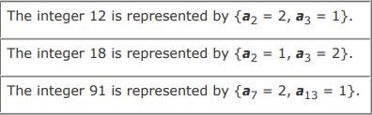

Prime Numbers
Any integer a > 1 can be factored in a unique way as
where p₁ < p₂ < ... < p_{t} are prime numbers and where each is a positive integer.
This is known as the fundamental theorem of arithmetic; a proof can be found in any text on number theory..
If P is the set of all prime numbers, then any positive integer a can be written uniquely in the following form.
The right-hand side is the product over all possible prime numbers p; for any particular value of a, most of the exponents a_{p} will be 0.

Slide 4




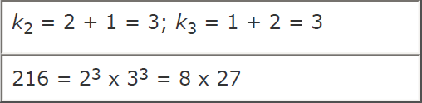
Prime Factors
Multiplication of two numbers is equivalent to adding the corresponding exponents.
Define k = ab. Integer k can be expressed as the product of powers of primes.
It follows that k_{p} = a_{p} + b_{p} for all
The prime factors of a and b, to say that a divides b? Any integer of the form can be divided only by an integer that is of a lesser or equal power of the same prime number, pj with j<= n.

Slide 5
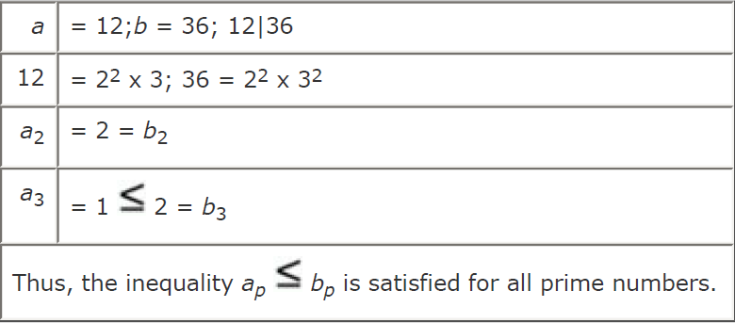

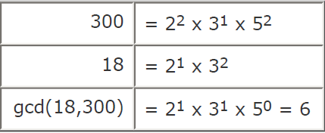
Prime Factors
It is easy to determine the greatest common divisor of two positive integers if we express each integer as the product of primes.
If k = gcd(a,b) then k_{p} = min(a_{p}, b_{p}) for all p.

Slide 6
2.Fermat’s Theorem
If p is a prime and a is a positive integer with p ∤ a , then a^{p−1}≡1(mod p).
Consider the set of positive integers less than p:{1,2,..., p-1} and multiply each element by a modulo p, to get the set X = {a mod p, 2a mod p, . . . (p-1)a mod p}.
None of the elements of X is equal to zero because p does not divide a.
No two of the integers in X are equal.
Assume that ja ≡ ka(mod p) where 1 <= j < k <= p-1. Because a is relatively prime to p, we can eliminate a from both sides of the equation resulting in: j ≡ k(mod p).
This last equality is impossible because j and k are both positive integers less than p.
We know that the (p-1) elements of X are all positive integers, with no two elements equal.

Slide 7

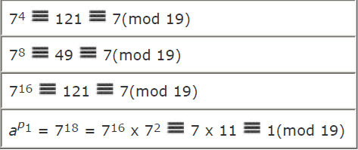
Example for Fermat’s Theorem
Can conclude that X consists of the set of integers {1,2,..., p-1} in some order.
Multiplying the numbers in both sets and taking the result mod p yields
a x 2a x ... x (p-1) ≡ [(1 x 2 x ... x (p-1)](mod p)
a^{p-1}(p-1)! ≡ (p-1)!(mod p)
a^{p-1} ≡ 1 (mod p)

Slide 8
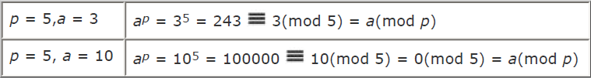
Fermat’s Little Theorem
An alternative form of Fermat's theorem is also useful: If p is prime and a is a positive integer, then a^{p} ≡ a(mod p).
Note: that the first form of the theorem requires that a be relatively prime to p, but this form does not.

Slide 9
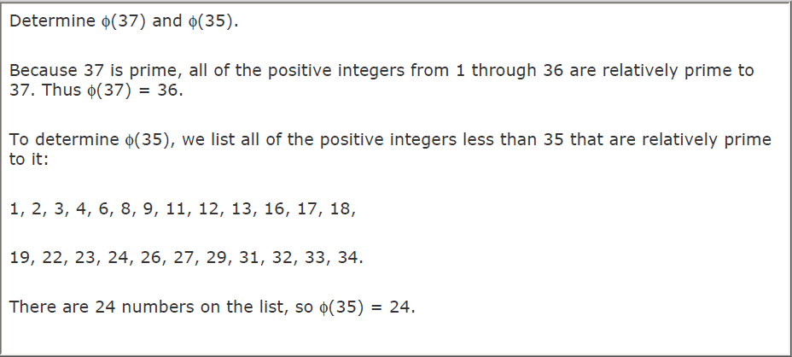
3.Euler’s Theorem & Euler’s Totient Function
Euler's totient function written (n), defined as the number of positive integers less than n and relatively prime to n. By convention, (1) = 1.

Slide 10

Euler’s Totient Function
It should be clear that for a prime number p, f(p) = p-1
Now suppose that we have two prime numbers p and q, with p not equal to q. Then we can show that for n = pq,
Consider that the set of positive integers less that n is the set {1,..., (pq-1)}.
The integers in this set that are not relatively prime to n are the set {p,2 p,..., (q-1)p} and the set {q,2q,..., (p-1)q}
(n) = (pq-1)[(q-1)+(p-1)]
= pq(p+q)+1
= (p-1)(q-1)

Slide 11


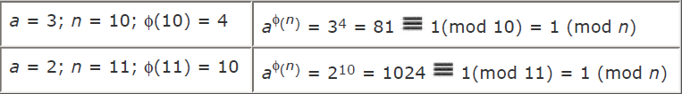
Euler’s Theorem
Euler's theorem states that for every a and n that are relatively prime
Consider the set of such integers, labeled as follows:
Each element x_{i} of R is a unique positive integer less than n with gcd(x_{i}, n) = 1.
Multiply each element by a, modulo n.
The set S is a permutation of R, by the following line of reasoning
Since ‘a’ is relatively prime to n and x_{i} is relatively prime to ‘n’, ax_{i} must also be relatively prime to n.
Thus, all the members of S are integers that are less than n and that are relatively prime to n. There are no duplicates in S.

Slide 12
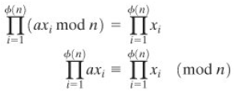


Euler’s Theorem
If ax_{i} mod n = ax_{j} mod n then x_{i} = x_{j}.
This is the same line of reasoning applied to the proof of Fermat's theorem.
As is the case for Fermat's theorem, an alternative form of the theorem is also useful.
The first form of Euler's theorem requires that a be relatively prime to n, but this form does not.

Slide 13
4.Testing for Primality
Used to test a large number for primality.
any positive odd integer n >=3 can be expressed as follows: n-1=2^{k}q with k > 0, q odd.
n-1 is an even integer. Divide (n-1) by 2 until the result is an odd number q, for a total of k divisions.
If n is expressed as a binary number, then the result is achieved by shifting the number to the right until the rightmost digit is a 1, for a total of k shifts.
Two Properties of Prime Numbers
- If p is prime and a is a positive integer less than p, then a² mod p =1. If and only if either a mod p = 1 or a mod p= 1 mode p = p-1.
- Let p be a prime number greater than 2. We can then write p-1 =2^{k}q, with k > 0 q odd. Let a be any integer in the range 1 < a < p-1.

Slide 14
Miller Rabin
if n is prime. We have p-1 =2^{k}q. Thus, we know that a^{p-1} mod p = a^{2kq} mod p = 1.
Simple algorithm based on Miller Rabin to check for prime number
Step:1 Perform n-1 computation. n-1=m*2^{k}
Step:2a if k<=1, Compute T= a^{m} mod n & check value for T.
- if T ==+-1, then n is prime, else composite/Non-prime.
Step:2b if k >1, Compute T=T² mod n and check T value.
if (T==1), then n is composite/Non-prime.
if (T==-1), then u is prime.
else, n is composite/Non-prime.

Slide 15
Miller Rabin - Example
Apply Miller rabin test to check whether the given number n=27, a=2, such that n is prime.
Step:1 n-1 = 27-1 = m * 2^{k}
26 = 13 * 2¹
Step:2a k<=1, must be done.
Compute T = a^{m} mod n
= 2¹³ mod 27
= 2⁵ * 2⁵ * 2³ mod 27
= 5*5*8 mod 27
= 200 mod 27
T = 11
Since our T not equal to +-1, then we can say that n is composite / non-prime.

Slide 16
4.The Chinese Remainder Theorem
It is possible to reconstruct integers in a certain range from their residues modulo a set of pairwise relatively prime moduli.
Example
Lets consider 10 integers in Z₁₀, that is the integers 0 through 9, can be reconstructed from their two residues modulo 3 and 5 (the relatively prime factors of 10).
x ≡ 2 mod 3
x ≡ 3 mod 5
The known residues of a decimal digit x are r₃ = 2 and r₅ = 3; that is, x mod 3 = 2 and x mod 5 = 3.
x is an even integer in Z₁₀ whose remainder, on division by 5, is 3.
The unique solution is x = 8.

Slide 17
The CRT - Example-1
For a given sequence of different linear equations.
x ≡ a₁ mod m₁
x ≡ a₂ mod m₂
x ≡ a₃ mod m₃
.
.
.
x ≡ a_{n} mod m_{n}
Solution can be obtained by applying this equation:
x = (a₁M₁ M₁⁻¹ + a₂M₂ M₂⁻¹ .........+ a_{n}M_{n}M_{n}⁻¹) mod M
With the condition that m₁,m₂,m₃ ….m_{n} should be relatively prime.

Slide 18
The CRT - Example-1
1. Solve for the following congruency using the Chinese Remainder Theorem:
x ≡ 2 mod 3
x ≡ 3 mod 5
x ≡ 2 mod 7
Step:1 Check whether m1,m2,m3 are relatively prime. If so, proceed. Else stop.
Step:2 Construct the below table from the given data and find missing values.
a₁ | 2 | M₁
a₂ | 3 | M₂
a₃ | 2 | M₃
m₁ | 3 | M₁⁻¹
m₂ | 5 | M₂⁻¹
m₃ | 7 | M₃⁻¹

Slide 19
The CRT - Example-1
Step:3 Compute M using the formula M=m₁*m₂*m₃
M = 3*5*7 = 105
Step:4 Compute M₁, M₂, M₃ using obtained M value and the formula M_{n}=M/m_{n}.
M1: M₁ = M / m₁ = 105 / 3 = 35
M2: M₂ = M / m₂ = 105 / 5 = 21
M3: M₃ = M / m₃ = 105 / 7 = 15
Update these values in the table we get.
a₁ | 2 | M₁ | 35
a₂ | 3 | M₂ | 21
a₃ | 2 | M₃ | 15
m₁ | 3 | M₁⁻¹
m₂ | 5 | M₂⁻¹
m₃ | 7 | M₃⁻¹

Slide 20
The CRT - Example-1
Step:5 Find respective multiplicative inverse for the values M₁,M₂,M₃.
We know that M_{n}* M_{n}⁻¹ ≡ 1 mod m₁
By applying this we compute:
M₁⁻¹ : M₁* M₁⁻¹ ≡ 1 mod m₁
M₂⁻¹ : M₂* M₂⁻¹ ≡ 1 mod m₂
M₃⁻¹ : M₃* M₃⁻¹ ≡ 1 mod m₃
M₁⁻¹ : 35 * 2 ≡ 1 mod 3 => 2
M₂⁻¹ : 21 * 1 ≡ 1 mod 5 => 1
M₃⁻¹ : 15 * 1 ≡ 1 mod 7 => 1
Final updated table is:
a₁ | 2 | M₁ | 35
a₂ | 3 | M₂ | 21
a₃ | 2 | M₃ | 15
m₁ | 3 | M₁⁻¹ | 2
m₂ | 5 | M₂⁻¹ | 1
m₃ | 7 | M₃⁻¹ | 1

Slide 21
The CRT - Example-1
x = (a₁M₁ M₁⁻¹ + a₂M₂ M₂⁻¹ + a₃M₃M₃⁻¹) mod M
Substitute appropriate values in equation x we get:
x = (2*35*2 + 3*21*1 + 2*15*1) mod 105
= (140 + 63 + 30) mod 105
= 233 mod 105
x = 23
Now, check for the obtained result, the given congruence equations:
23 ≡ 2 mod 3
23 ≡ 3 mod 5
23 ≡ 2 mod 7

Slide 22
5.Public Key Cryptography
Most significant advance in the 3000 year history of cryptography.
Uses two keys – a public & a private key.
Asymmetric since parties are not equal.
Uses clever application of number theoretic concepts to function.
Complements rather than replaces private key cryptography.
Developed to address two key issues:
Key Distribution – how to have secure communications in general without having to trust a KDC with your key.
Digital Signatures – how to verify a message comes intact from the claimed sender.
Public invention due to Whitfield Diffie & Martin Hellman at Stanford University in 1976.

Slide 23
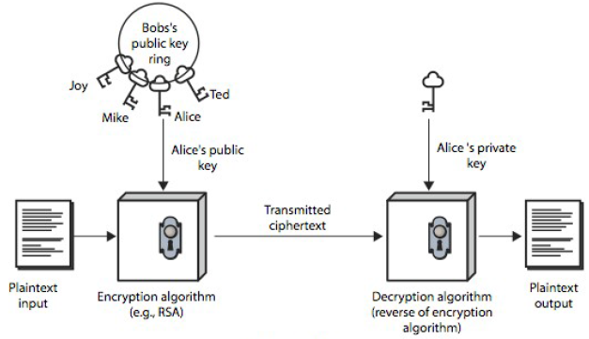
Public Key Cryptography
Public-key / two-key / asymmetric cryptography involves the use of two keys:
- A public-key, which may be known by anybody, and can be used to encrypt messages, and verify signatures.
- A private-key, known only to the recipient, used to decrypt messages, and sign (create) signatures.
Asymmetric - those who encrypt messages or verify signatures cannot decrypt messages or create signatures.

Slide 24
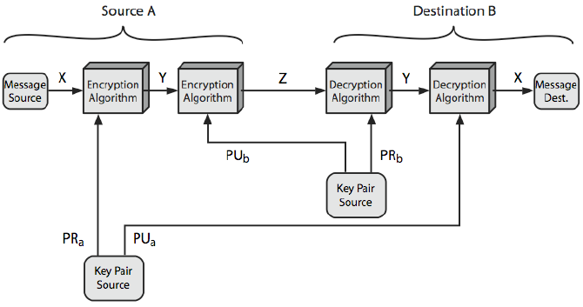
Characteristics of Public Key Cryptography
Computationally infeasible to find decryption key knowing only algorithm & encryption key.
Computationally easy to en/decrypt messages when the relevant (en/decrypt) key is known.
Either of the two related keys can be used for encryption, with the other used for decryption (for some algorithms).

Slide 25
Public Key Applications & Security
Encryption / Decryption (provide secrecy)
Digital Signatures (provide authentication)
Key Exchange (of session keys)
Some algorithms are suitable for all uses, others are specific to one.
Security
Brute force exhaustive search attack is always theoretically possible.
If keys used are too large then it is difficult(>512bits).
Security relies on a large enough difference in difficulty between easy (en/decrypt) and hard(cryptanalyse) problems.
The hard problem is known, but is made hard enough to be impractical to break.
Requires the use of very large numbers, hence is slow compared to private key schemes

Slide 26
RSA Introduction
Rivest, Shamir & Adleman of MIT in 1977
Best known & widely used public-key scheme
Based on exponentiation in a finite (Galois) field over integers modulo a prime
- nb. exponentiation takes O((log n)³) operations (easy)
uses large integers (eg. 1024 bits)
security due to cost of factoring large numbers
- nb. factorization takes O(e ^{log n log log n}) operations (hard)

Slide 27
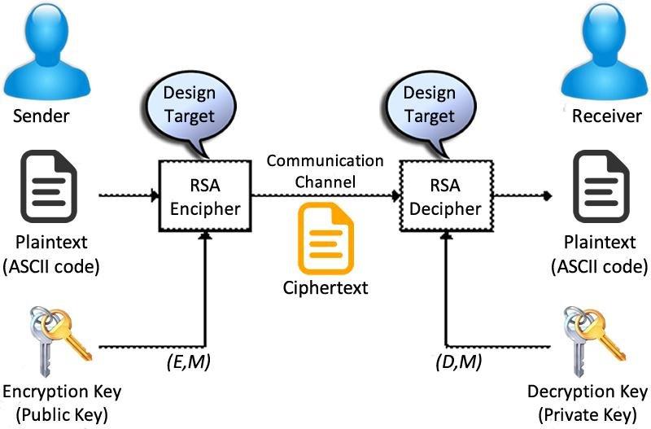
The RSA Public Key Cryptosystem

Slide 28
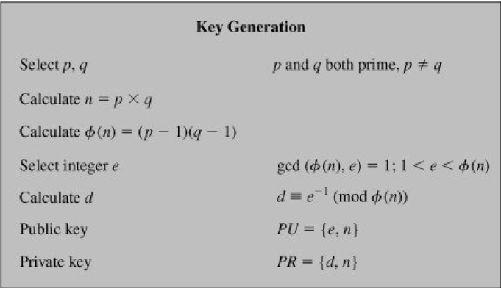
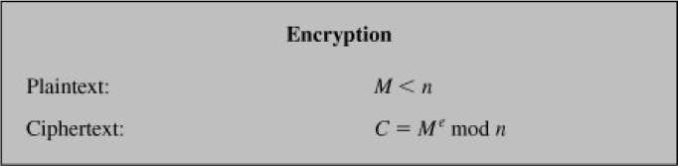
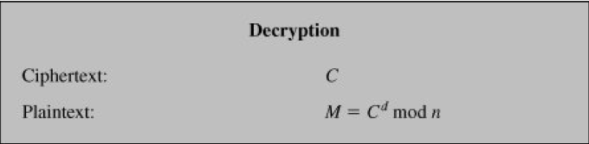
RSA Key Setup & Working

Slide 29
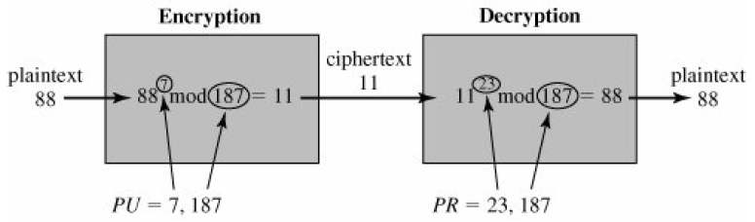
RSA Example
1. Select primes: p=17 & q=11
2. Compute n = pq =17 x 11=187
3. Compute ø(n)=(p–1)(q-1)=16 x 10=160
4. Select e: gcd(e,160)=1; choose e=7
5. Determine d: de =1 mod 160 and d < 160
Value is d=23 since 23x7=161= 10x160+1
6. Publish public key PU={7,187}
7. Keep secret private key PR={23,187}

Slide 30
RSA Security
Possible approaches to attacking RSA are:
Brute force key search (infeasible given size of numbers)
Mathematical attacks (based on difficulty of computing ø(n), by factoring modulus n)
Timing attacks (on running of decryption)
Chosen ciphertext attacks (given properties of RSA)

Slide 31
Factoring Problem
Mathematical approach takes 3 forms:
Factor n=p.q, hence compute ø(n) and then d.
Determine ø(n) directly and compute d.
Find d directly.
Currently believe all equivalent to factoring.
Have seen slow improvements over the years
- as of May-05 best is 200 decimal digits (663) bit with LS
Biggest improvement comes from improved algorithm.
Currently assume 1024-2048 bit RSA is secure.
- ensure p, q of similar size and matching other constraints

Slide 32
Timing Attacks
Developed by Paul Kocher in mid-1990’s
Exploit timing variations in operations
- eg. multiplying by small vs large number
- IF's varying which instructions executed
Infer operand size based on time taken
RSA exploits time taken in exponentiation , countermeasures includes:
Use constant exponentiation time.
Add random delays.
Blind values used in calculations.

Slide 33
Chosen Ciphertext Attacks
RSA is vulnerable to a Chosen Ciphertext Attack (CCA)
Attackers chooses ciphertexts & gets decrypted plaintext back.
Choose ciphertext to exploit properties of RSA to provide info to help cryptanalysis.
Can counter with random pad of plaintext or use Optimal Asymmetric Encryption Padding (OASP).

Slide 34
6.Key Management & Distribution
Key Management
Public-key encryption helps address key distribution problems.
Have two aspects of this:
I. Distribution of public keys.
II. Use of public-key encryption to distribute secret keys.
I. Distribution of public keys
Can be considered as using one of the following approaches:
Public announcement
Publicly available directory
Public-key authority
Public-key certificates

Slide 35
6.a.Public Announcement
Users distribute public keys to recipients or broadcast to community at large.
- eg. append PGP keys to email messages or post to news groups or email list.
Major weakness is forgery.
Anyone can create a key claiming to be someone else and broadcast it.
Until forgery is discovered anyone with forged key can masquerade as claimed user.

Slide 36
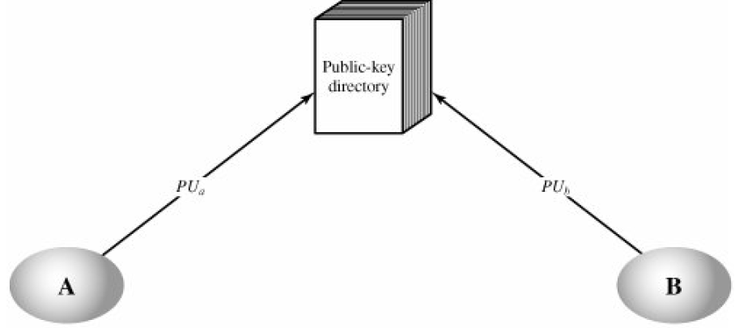
6.b.Publicly Available Directory
Can obtain greater security by registering public keys with a publicly available dynamic directory.
Directory must be trusted with properties:
Contains {name, public-key} entries.
Participants register securely with directory authority.
Participants can replace key at any time.
Directory is periodically published.
Directory can be accessed electronically.
Still vulnerable to tampering or forgery.

Slide 37
6.c.Public Key Authority
Improves security by tightening control over distribution of keys from directory.
Has properties of directory.
Requires users to know public key for the directory.
Users interact with directory to obtain any desired public key securely.
Require real-time access to directory when keys are needed.

Slide 38
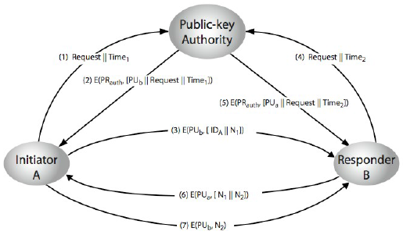
6.c.Public Key Authority

Slide 39
6.d.Public Key Certificates
Certificates allow key exchange without real-time access to public-key authority.
A certificate binds identity to public key.
With information such as period of validity, rights of use etc.
With all contents signed by a trusted Public-Key or Certificate Authority (CA).
Can be verified by anyone who knows the public-key authorities public-key.

Slide 40
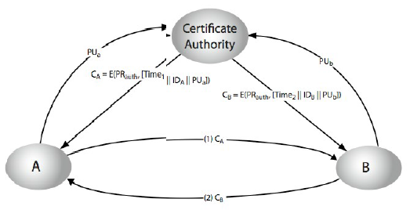
6.d.Public Key Certificates

Slide 41
II.Public-Key Distribution of Secret Keys
Use previous methods to obtain public-key.
Can use for secrecy or authentication.
Public-key algorithms are slow.
So usually want to use private-key encryption to protect message contents.
Need a session key.
Have several alternatives for negotiating a suitable session.

Slide 42
Simple Secret Key Distribution
Proposed by Merkle in 1979.
A generates a new temporary public key pair.
A sends B the public key and their identity.
B generates a session key K sends it to A encrypted using the supplied public key.
A decrypts the session key and both use.
Problem is that an opponent can intercept and impersonate both halves of protocol.

Slide 43
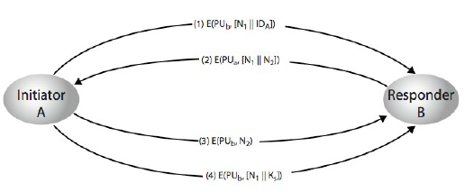
Public-Key Distribution of Secret Keys

Slide 44
Hybrid Key Distribution
Retain use of private-key KDC
Shares secret master key with each user
Distributes session key using master key
Public-key used to distribute master keys especially useful with widely distributed users
Rationale - performance, backward compatibility

Slide 45
6.e.Diffie-Hellman Key Exchange
First public-key type scheme proposed by Diffie & Hellman in 1976 along with the exposition of public key concepts.
Now know that Williamson (UK CESG)
Secretly proposed the concept in 1970, is a practical method for public exchange of a secret key.
Used in a number of commercial products.

Slide 46
Diffie-Hellman Key Exchange
A public-key distribution scheme.
Cannot be used to exchange an arbitrary message.
Rather it can establish a common key known only to the two participants.
Value of key depends on the participants (and their private and public key information)
Based on exponentiation in a finite (Galois) field (modulo a prime or a polynomial) – easy.
Security relies on the difficulty of computing discrete logarithms (similar to factoring) – hard.

Slide 47
Diffie-Hellman Setup
All users agree on global parameters:
Large prime integer or polynomial q.
α being a primitive root of q.
Each user (eg. A) generates their keys (private & public).
Chooses a secret key (number): x_{A} < q
Compute their public key: y_{A} = α^{x}_{A} mod q
Each user makes public that key y_{A}

Slide 48
Diffie-Hellman Key Exchange
Shared session key for users A & B is K_{AB} :
K_{AB} = a^{xA. xB} mod q
= y_{A}^{xB} mod q (which B can compute)
= y_{B} ^{xA} mod q (which A can compute)
K_{AB} is used as session key in private-key encryption scheme between Alice and Bob.
If Alice and Bob subsequently communicate, they will have the same key as before, unless they choose new public-keys.
Attacker needs an x, must solve discrete log.

Slide 49
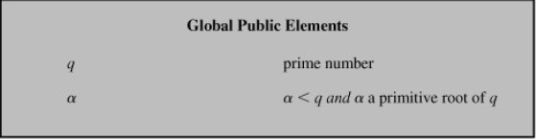
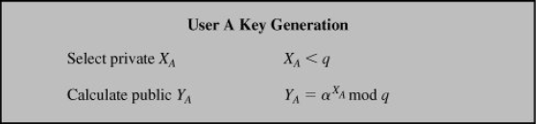
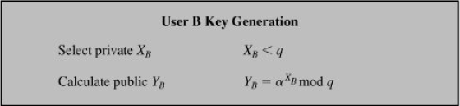


Diffie-Hellman Key Exchange

Slide 50
Diffie-Hellman Example
Given, q=7, Choose such that it is a primitive root of q and α<q, Therefore α=2.
User A Key Generation
i) X_{A} = 3, X_{A}<7
ii) Y_{A} = α^{XA} mod q
= 2³ mod 7
= 8 mod 7
Y_{A} = 1
Secret Key Generation by A
K_{A} = (Y_{B})^{XA} mod q
= 2³ mod 7
= 8 mod 7
K_{A} = 1
User B Key Generation
i) X_{B} = 4, X_{B}<7
ii) Y_{B} = α^{XB} mod q
= 2⁴ mod 7
= 16 mod 7
Y_{B}= 2
Secret Key Generation by B
K_{B} = (Y_{A})^{XB} mod q
= 1⁴ mod 7
= 1 mod 7
K_{B} = 1
Both Values K_{A} & K_{B} are Equal

Slide 51
Key Exchange Protocol
Users could create random private/public D-H keys each time they communicate
Users could create a known private/public D-H key and publish in a directory, then
Consulted and used to securely communicate with them
Both of these are vulnerable to a meet in the Middle Attack.
Authentication of the keys are needed.

Slide 52
Elliptic Curve Cryptography
Majority of public-key crypto (RSA, D-H) use either integer or polynomial arithmetic with very large numbers / polynomials.
Imposes a significant load in storing and processing keys and messages.
An alternative is to use elliptic curves.
Offers same security with smaller bit sizes.
Newer, but not as well analysed.

Slide 53
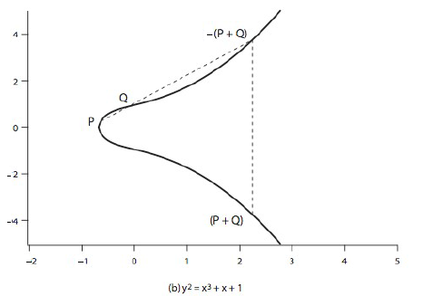
Real Elliptic Curves
An elliptic curve is defined by an equation in two variables x & y, with coefficients.
Consider a cubic elliptic curve of form y² = x³ + ax + b, where x, y, a, b are all real numbers, also define zero point O.
Have addition operation for elliptic curve.
Geometrically sum of P+Q is reflection of intersection –(P+Q).

Slide 54
Finite Elliptic Curves
Elliptic curve cryptography uses curves whose variables & coefficients are finite.
Have two families commonly used:
Prime curves E_{p}(a,b) defined over Z_{p}
- use integers modulo a prime.
- best in software.
Binary curves E_{2m}(a,b) defined over GF(2^{n})
- use polynomials with binary coefficients.
- best in hardware.

Slide 55
Elliptic Curve Cryptography
ECC addition is analog of modulo multiply
ECC repeated addition is analog of modulo exponentiation
Need “hard” problem equiv to discrete log(Trapdoor Function)
- Q=kP, where Q,P belong to a prime curve
- Is “easy” to compute Q given k,P.
- But “hard” to find k given Q,P.
- Known as the elliptic curve logarithm problem.
Certicom example: E₂₃(9,17)

Slide 56
ECC Diffie-Hellman
Can do key exchange analogous to D-H.
Users select a suitable curve E_{p}(a,b).
Select base point G=(x₁,y₁).
- with large order n such that nG=O.
A & B select private keys n_{A}<n, n_{B}<n.
Compute public keys: P_{A}=n_{A}G, P_{B}=n_{B}G.
Compute shared key: K_{A}=n_{A}P_{B}, K_{B}=n_{B}P_{A}.
Same since, K=n_{A}n_{B}G.

Slide 57
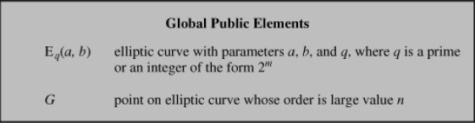
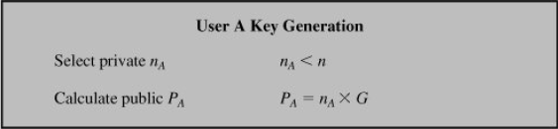
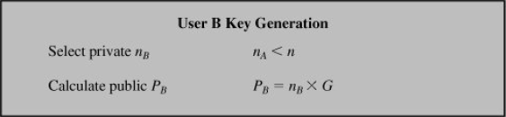


ECC Diffie-Hellman Key Exchange

Slide 58
ECC Encryption & Decryption
Several alternatives, will consider simplest
Must first encode any message M as a point on the elliptic curve P_{m}.
Select suitable curve & point G as in D-H
Each user chooses private key n_{A}<n.
Computes public key P_{A}=n_{A}G
To encrypt P_{m} Compute: C_{m}={kG, P_{m}+kP_{b}}, k random number.
To decrypt C_{m} compute:
P_{m}+kP_{b}–n_{B}(kG) = P_{m}+k(n_{B}G)–n_{B}(kG) = P_{m}.

Slide 59
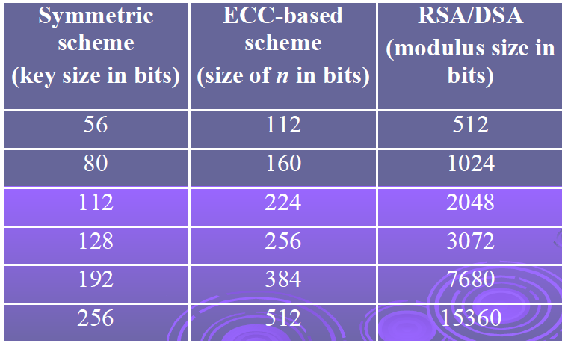
ECC Security
Relies on elliptic curve logarithm problem.
Fastest method is “Pollard rho method”.
Compared to factoring, can use much smaller key sizes than with RSA etc.
For equivalent key lengths computations are roughly equivalent.
Similar security ECC offers significant computational advantages.

